Slide 1
Finding Demand

Slide 2
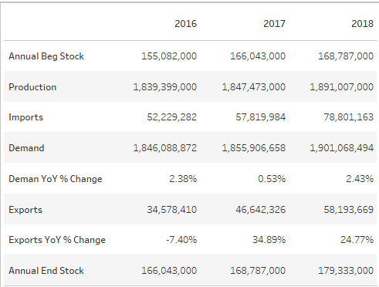
Reverse Engineering USDA Data
USDA
Our Data
 | Supply |  |  |  | USDA net removals, barters, and CCC donations¹ | Commercial use
Year | Beginning commercial stocks | Production | Imports | Total supply |  | Domestic commercial disappearance | Commercial exports ² | Total commercial disappearanc | Ending commercial stocks ³
1995 | 12.2 | 1264.5 | 1.0 | 1277.7 | 77.8 | 1139.6 | 44.5 | 1184.1 | 15.8
1996 | 15.8 | 1174.5 | 4.6 | 1194.9 | 0.1 | 1157.1 | 24.3 | 1181.4 | 13.4
1997 | 13.4 | 1151.3 | 12.4 | 1177.1 | 38.4 | 1118.2 | 0.0 | 1118.2 | 20.5
1998 | 20.5 | 1168.0 | 41.0 | 1229.5 | 6.3 | 1197.2 | 0.0 | 1197.2 | 25.9
1999 | 25.9 | 1277.1 | 15.6 | 1318.6 | 3.7 | 1290.0 | 0.0 | 1290.0 | 24.9
2000 | 24.9 | 1256.0 | 16.0 | 1296.9 | 8.9 | 1262.7 | 1.4 | 1264.1 | 24.0
2001 | 24.0 | 1231.8 | 45.5 | 1301.3 | 0.0 | 1242.5 | 3.3 | 1245.8 | 55.5
2002 | 55.5 | 1355.1 | 17.5 | 1428.2 | 0.0 | 1267.9 | 3.0 | 1270.9 | 157.3
2003 | 157.3 | 1242.4 | 16.3 | 1415.9 | 29.1 | 1293.1 | 0.3 | 1293.4 | 93.4
2004 | 93.4 | 1246.7 | 37.1 | 1377.3 | -6.6 | 1325.9 | 13.0 | 1339.0 | 44.9
2005 | 44.9 | 1347.4 | 21.7 | 1414.0 | 0.0 | 1345.7 | 9.7 | 1355.4 | 58.5
2006 | 58.5 | 1448.4 | 19.4 | 1526.4 | 0.0 | 1399.4 | 18.5 | 1417.9 | 108.5
2007 | 108.5 | 1532.7 | 17.0 | 1658.2 | 0.0 | 1430.5 | 72.6 | 1503.1 | 155.1
2008 | 155.1 | 1644.1 | 12.7 | 1811.9 | 0.0 | 1517.5 | 175.4 | 1692.9 | 119.0
2009 | 119.0 | 1572.5 | 15.6 | 1707.0 | 23.3 | 1524.6 | 26.1 | 1550.7 | 133.0
2010 | 133.0 | 1564.0 | 8.1 | 1705.1 | 5.6 | 1524.1 | 93.6 | 1617.7 | 81.7
2011 | 81.7 | 1809.8 | 10.2 | 1901.7 | 0.0 | 1679.7 | 115.1 | 1794.8 | 106.9
2012 | 106.9 | 1859.5 | 15.2 | 1981.6 | 0.0 | 1733.1 | 95.5 | 1828.6 | 153.0
2013 | 153.0 | 1862.5 | 11.7 | 2027.3 | 0.0 | 1736.5 | 178.3 | 1914.8 | 112.5
2014 | 112.5 | 1855.3 | 24.1 | 1991.9 | 0.0 | 1757.2 | 130.0 | 1887.2 | 104.7
2015 | 104.7 | 1849.5 | 41.3 | 1995.6 | 0.0 | 1803.2 | 37.3 | 1840.5 | 155.1
2016 | 155.1 | 1839.4 | 52.2 | 2046.7 | 0.0 | 1846.1 | 34.6 | 1880.7 | 166.0
2017 | 166.0 | 1847.5 | 57.8 | 2071.3 | 0.0 | 1855.9 | 46.6 | 1902.5 | 168.8
2018 | 168.8 | 1891.0 | 78.8 | 2138.6 | 0.0 | 1901.2 | 58.0 | 1959.2 | 179.3

Slide 3
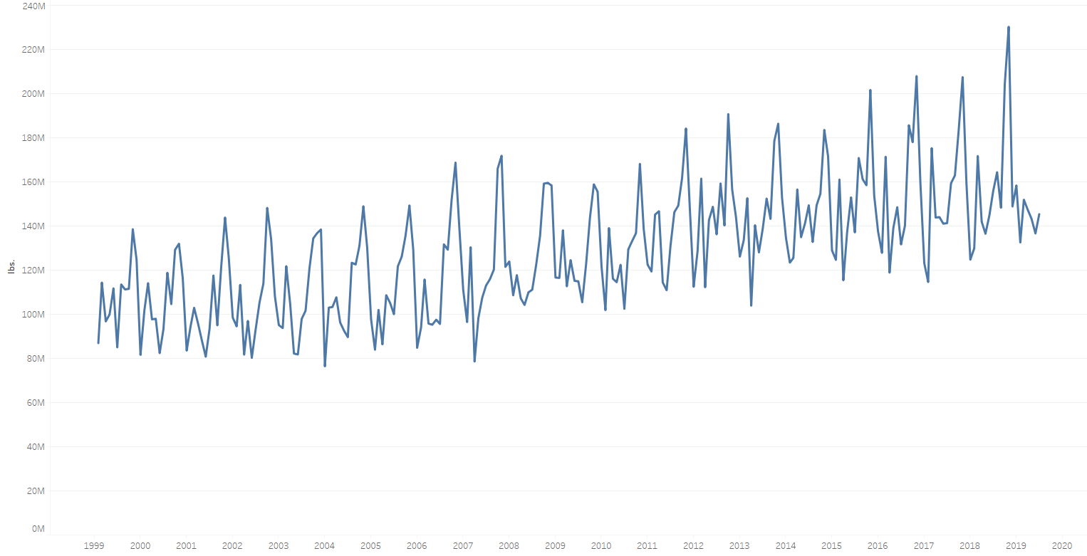
Month Over Month Demand
Demand for butter is growing year over year
Butter demand peaks in November

Slide 4
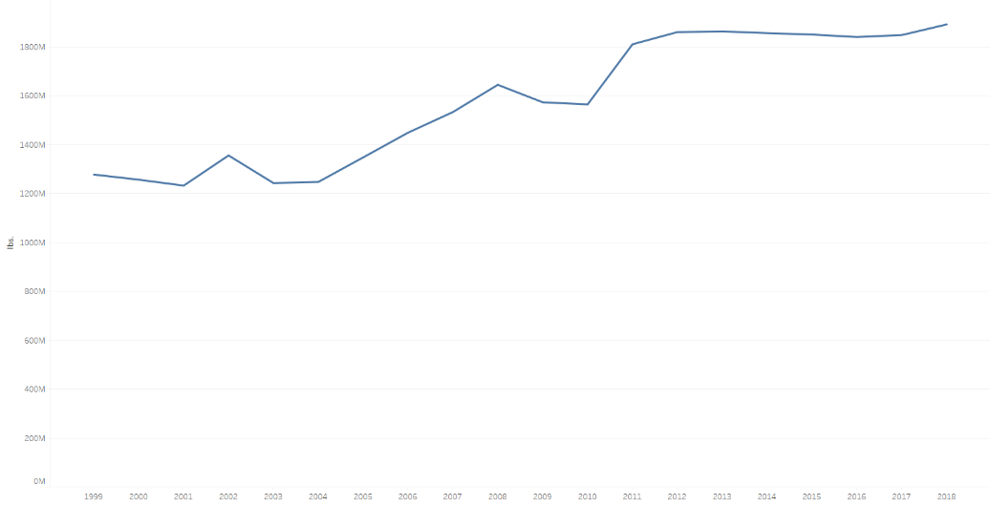
Production
Butter production is increasing to meet demand
Days of production peaks in July/August to meet the increase in demand during the holidays.

Slide 5
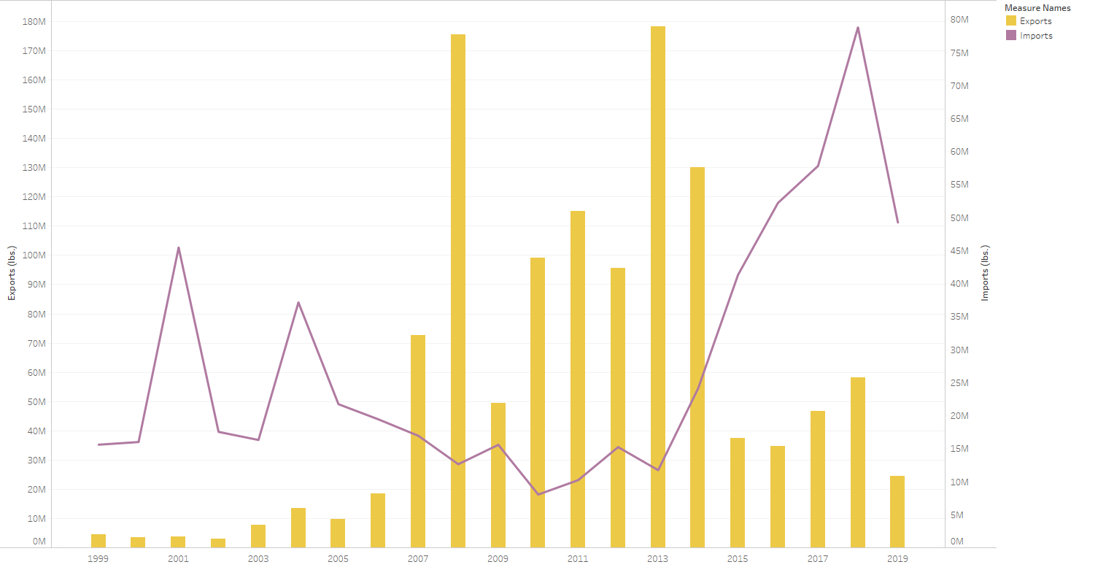
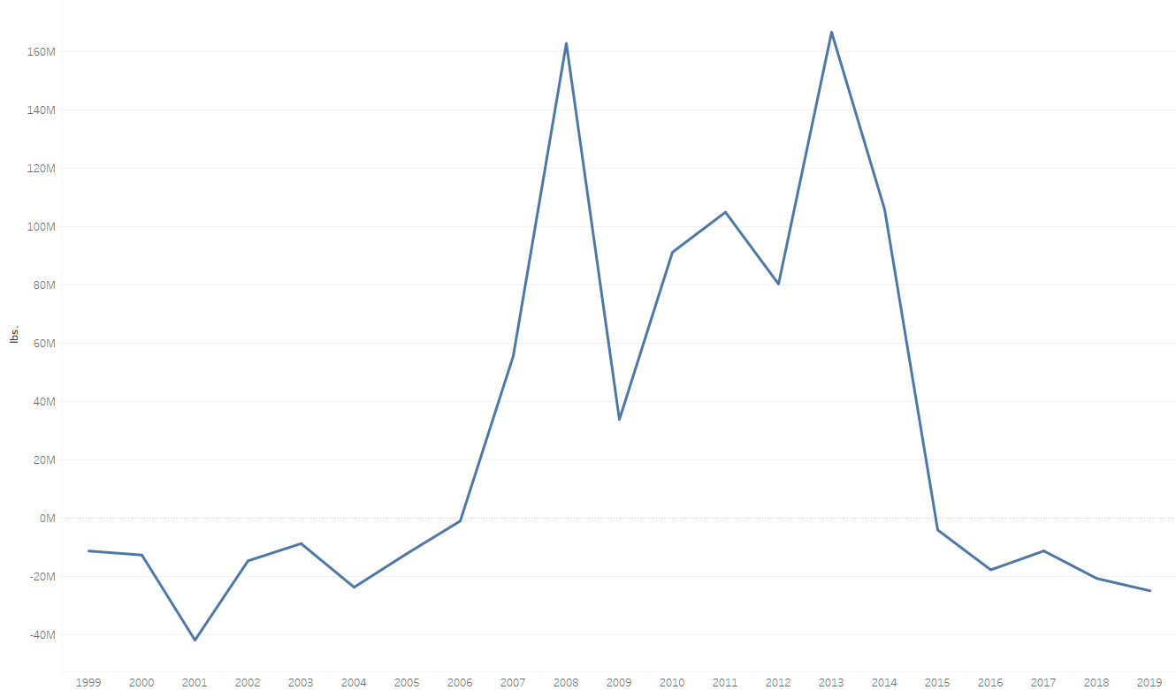
Butter Trade
Imports vs Exports
Net Exports
Exporting more butter than we import

Slide 6
Conclusion…
Butter market is growing
Demand is up and production is keeping up
Demand for butter peaks in November
Net trade is positive, we are exporting more butter than importing

